Slide 1
Chapter 5
Data Definition Language
Database
CCS5001

Slide 2
Learning Objectives
Explain what is SQL.
Define a database using the SQL data definition
Establish referential integrity using SQL
Grant or revoke privileges to access database or particular object within the database.

Slide 3
What is SQL?
SQL or Structured Query Language is an English-like language used to create and manipulate databases.
Three types of statements:
  Data Definition Language (DDL)
  Data Manipulation Language (DML)
  Data Control Language (DCL)
Data Definition Language creates and manipulates the structure that Data Manipulation Language fills. Data Control Language determines who is allowed to what within the database

Slide 4
Data Definition Language (DDL)
Used to create and modify database objects
  Create
  Drop
  Alter

Slide 5
Data Control Language (DCL)
Used to control database privileges
  Grant
  Revoke

Slide 6
Data Manipulation Language (DML)
Used to create, modify and retrieve data
  Insert
  Update
  Delete
  Select

Slide 7
DDL - Creating a Table
Use the Create keyword and specify:
  table name
  field (column) name(s)
  field type
  constraints
    primary key - unique identifier for a record
    foreign key - establishes relationship
    check - value must be in the specified list
    not null - must have a value
    unique - value must be unique

Slide 8
Example…
CREATE TABLE room(
roomID number,
bldg char(1) CHECK (bldg IN ('A','B')),
roomNo varchar2(10),
maxCapacity number,
style varchar2(15) CHECK (style IN ('LECTURE',
'LECTURE/LAB', 'LAB','OFFICE')),
CONSTRAINT room_pk PRIMARY KEY (roomID));

Slide 9
Example…
CREATE TABLE faculty(
facultyID number,
lname varchar2(30) NOT NULL,
fname varchar2(20) NOT NULL,
dept varchar2(5),
officeID number,
phone varchar2(15),
email varchar2(75) UNIQUE,
rank char(4) CHECK (rank IN ('INST','ASOC',
'ASST','FULL','SENR')),
CONSTRAINT faculty_pk PRIMARY KEY (facultyID),
CONSTRAINT faculty_fk FOREIGN KEY (officeID) REFERENCES room(roomID));

Slide 10
Table with Primary Key Only
CREATE TABLE room(
roomID number,
bldg char(1) CHECK (bldg IN ('A','B')),
roomNo varchar2(10),
maxCapacity number,
style varchar2(15) CHECK (style IN
('LECTURE','LECTURE/LAB','LAB','OFFICE')),
CONSTRAINT room_pk PRIMARY KEY (roomID));

Slide 11
Table with Foreign Key
CREATE TABLE faculty(
facultyID number,
lname varchar2(30) NOT NULL,
fname varchar2(20) NOT NULL,
dept varchar2(5),
officeID number,
phone varchar2(15),
email varchar2(75) UNIQUE,
rank char(4) CHECK (rank IN ('INST',
'ASOC','ASST','FULL','SENR')),
CONSTRAINT faculty_pk PRIMARY KEY (facultyID),
CONSTRAINT faculty_fk FOREIGN KEY (officeID) REFERENCES room(roomID));

Slide 12
Table with Compound Primary Key
create table participation(
eventID number,
memberID number,
constraint participation_pk primary key (eventID, memberID),
constraint participation_event_fk foreign key (eventID) references event(eventID),
constraint participation_member_fk foreign key (memberID) references member(memberID));

Slide 13
DDL – Altering table
Use the Alter and Add/Modify keywords and specify:
  table name
  new or existing field name(s)
  field type
  alter table invoice
  add(sent_dt date);
  alter table invoice
  modify (invoice_nbr varchar2(5));

Slide 14
DDL - Removing a Table
Use the Drop keyword and specify:
  table name
  drop table invoice;
If this table is referenced by a foreign key, use the cascade constraints clause
  drop table invoice cascade constraints;

Slide 15
Indexes
Conceptually similar to book index
Increases data retrieval efficiency
Automatically assigns record numbers
Used by DBMS, not by users
Fields on which index built called Index Key
Have a sorted order
Can guarantee uniqueness
Can include one or more fields

Slide 16
Indexes – Syntax
CREATE UNIQUE INDEX cust_num_ind ON
customer(Name);
CREATE INDEX CustomerName ON Customer (CustomerNum);
CREATE INDEX CreditLimitRep_ind ON Customer(CreditLimit, RepNum);
DROP INDEX RepBal;

Slide 17
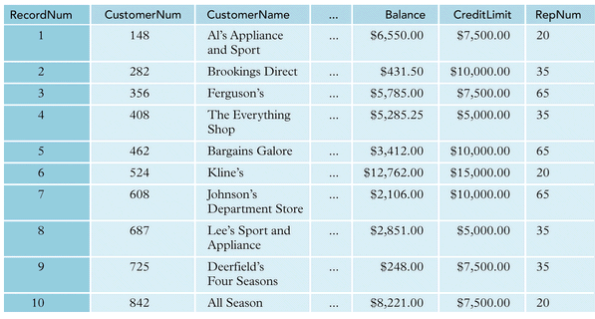
Customer Table with Record Numbers
Figure 4.10

Slide 18
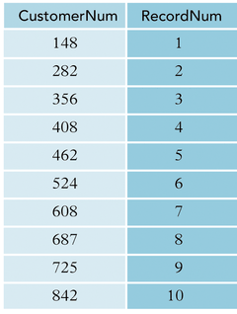
Customer Table Index on CustomerNum Figure 4.11

Slide 19
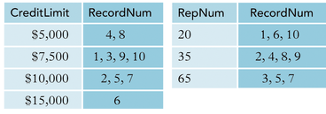
Table Indexes on CreditLimit, RepNum
Figure 4.12

Slide 20
Indexes
PROs
Faster/more efficient data retrieval
CONs
Requires additional space
Increased overhead

Slide 21
Data Control Language (DCL)
Used to control database privileges
  Grant
  Revoke

Slide 22
DCL – Grant Privilege
Use the Grant keywords and specify:
  Privilege
  {all, select, insert, update, delete, index, alter}
  existing field name(s)
  username
  Grant all on employee to salmi;
  Grant select on employee to public;
  Grant select, insert, delete on
  employee to ahmad;

Slide 23
DCL – Revoke Privilege
Use the Revoke keywords and specify:
  Privilege
  {all, select, insert, update, delete, index, alter}
  existing field name(s)
  username
  Revoke all on employee from salmi;
  Revoke select on employee from public;
  Revoke update, delete on employee from
  ahmad;

